Slide 1



{ }HACKER BRAIN
BIGBERT
RUTVIK KUMAR
IIT BHUBANESWAR

Slide 2


PROBLEM STATEMENT
Grab the Headlines!
Construct a ML model to classify news headlines into categories like national, international, business, sports, and health.
Notes:
Notes to presenter:
Description of what you learned in your own words on one side.
Include information about the topic
Details about the topic will also be helpful here.
Tell the story of your learning experience. Just like a story there should always be a beginning, middle and an end.
On the other side, you can add a graphic that provides evidence of what you learned.
Feel free to use more than one slide to reflect upon your process. It also helps to add some video of your process.

Slide 3

PIPELINE
Exploratory data analysis
Model Preparation
01
04
02
03
Deployment
Evaluation
Notes:
Notes to presenter:
What did you think at first?
What obstacles did you encounter along the way?
How did you overcome those obstacles?
What images can you add to support your process?
This SmartArt allows you add images and text to help outline your process. If a picture is worth a thousand words, then pictures and words should help you communicate this reflection on learning perfectly! You can always click on Insert>SmartArt to change this graphic or select the graphic and click on the Design contextual menu to change the colors.
Feel free to use more than one slide to reflect upon your process. It also helps to add some video of your process.

Slide 4


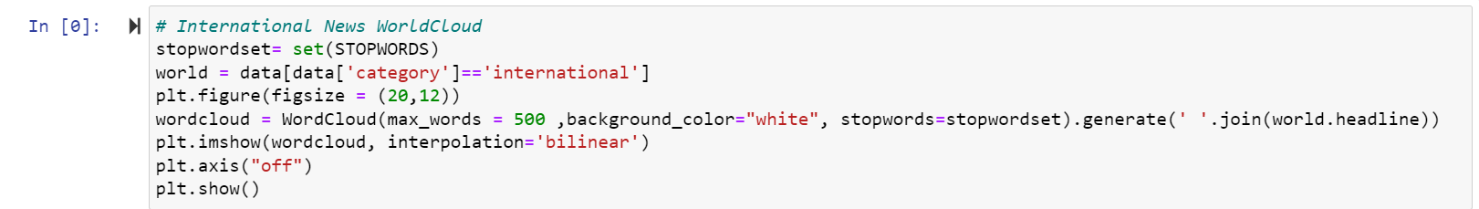
EDA
Word Cloud
Represent headline to indicate its frequency and importance

Slide 5
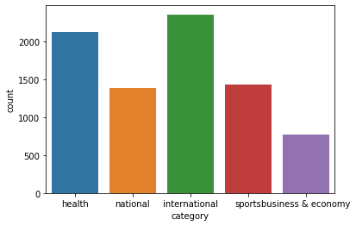
EDA
Countplot
To visualize the distribution of different news classes.

Slide 6

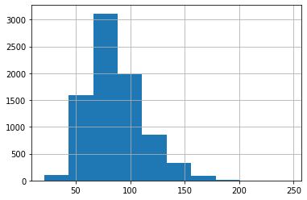
EDA
Histogram
To visualize the distribution of length of headline

Slide 7
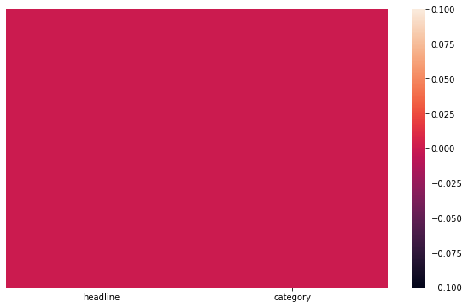
EDA
Heatmap
To check whether there is null value.

Slide 8

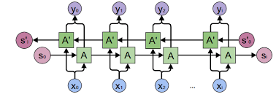
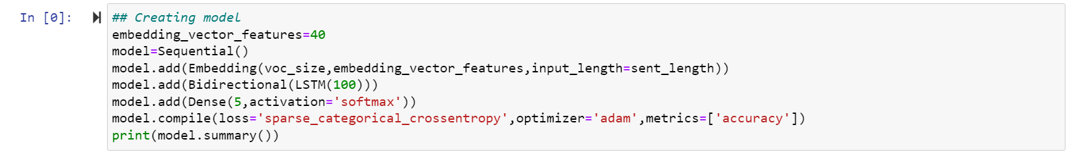
MODEL PREPARATION
Bi-Directional LSTM RNN
Tokenization, lowering, removing stopwords and lemmatization
Onehot representation, padding, word embedding
Bi-directional LSTM, dense layer with 5 output

Slide 9
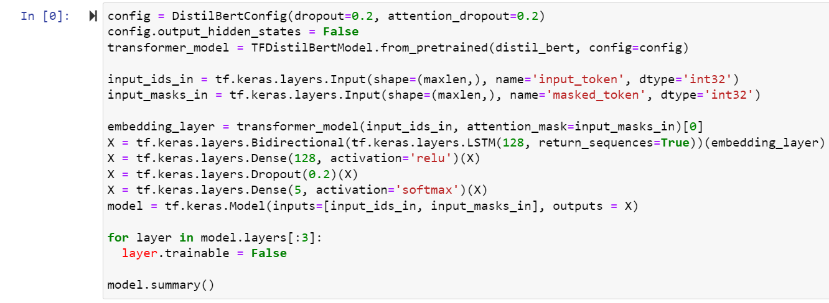
MODEL PREPARATION
Distilbert-Base-Uncased
Vocab size, embedded size, tokenizer.
Bi-directional LSTM, Dropout, dense layer with 5 output.

Slide 10
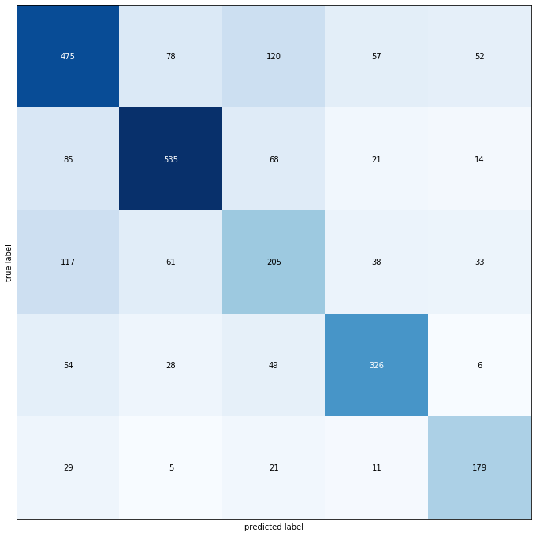
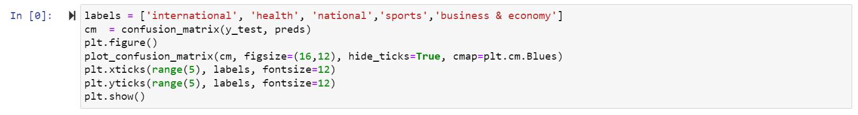
EVALUATION
Confusion Matrix
Accuracy, precision, sensitivity, specificity, F1-Score,etc.

Slide 11
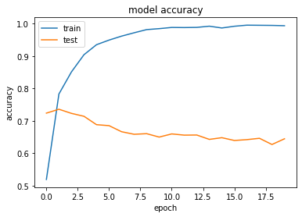
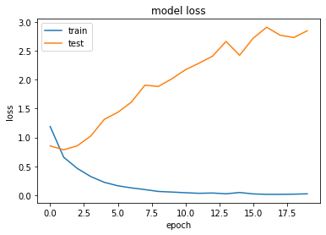
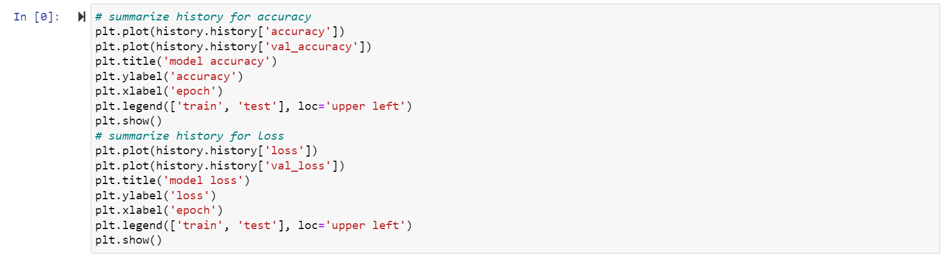
EVALUATION
Model Accuracy and Loss

Slide 12
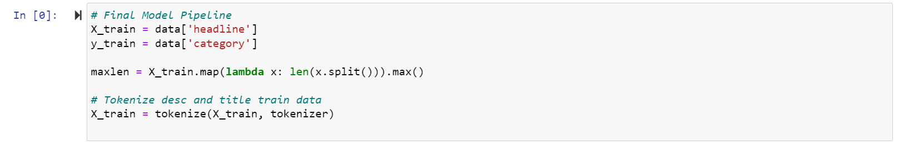
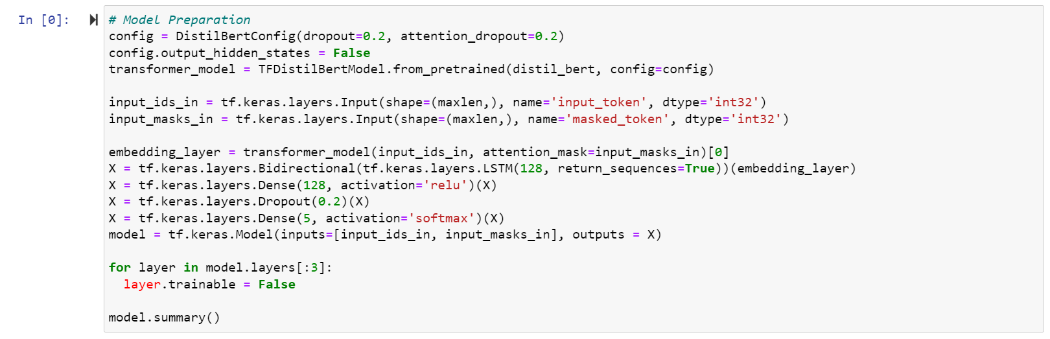
DEPLOYMENT

Slide 13
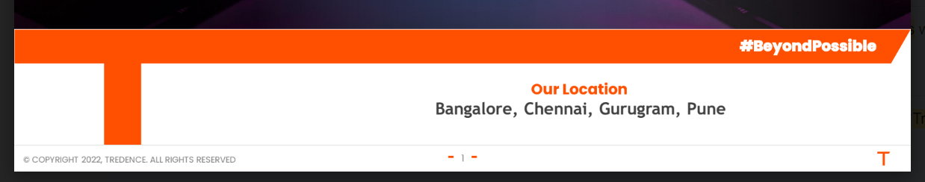
THANK YOU

